Slide 1
Monocular Depth Estimation from RGB Videos
EN.601.482/682 Deep Learning
Group 12: Rishi More/rmore2, Mingqi Sheng/msheng4, Rahul Chemitiganti/rchemit1, Rohan Allen/rallen67

Slide 2
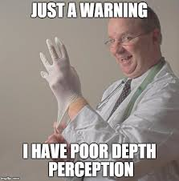
Why See in 2D When You Can Dive Into 3D?
Key Idea: Predict depth from a single RGB camera view
Challenges: Limited diversity in opensource datasets, Ambiguity, lighting variations, and occlusions

Slide 3
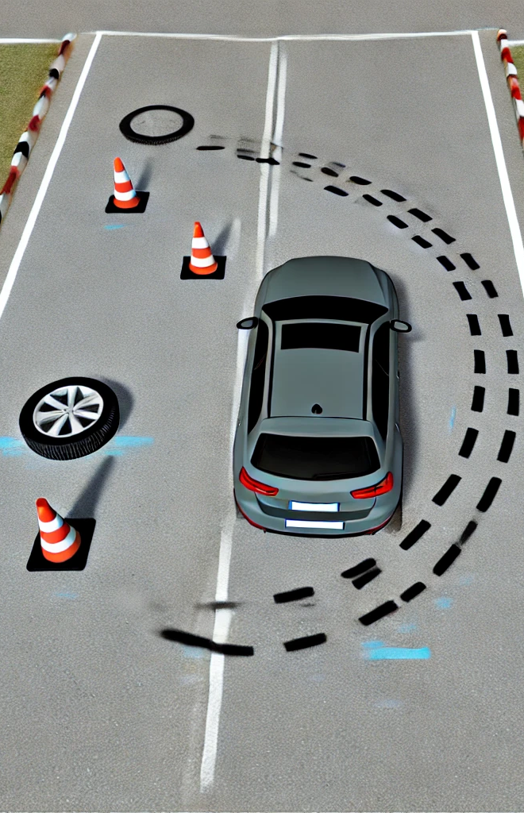
Goals: Decode the Depth!
Design a Self-Supervised Framework: Leverage temporal coherence for object segmentation as a surrogate task.
Fine-Tune with Supervised Learning: Optimize the self-supervised model using a limited labeled dataset.
Enable Real-Time Applications: Develop a model suitable for robotics, augmented reality (AR), and autonomous vehicles.

Slide 4

KITTI-ing It Right!
Dataset: KITTI – City and Road subsets, high-res videos, LIDAR scans.
Preprocessing: Resizing, normalization, and data restructuring.

Slide 5

Self-Supervised Learning
Proxy Task: Predict the the color of each object segmentation in the next frame, so that the model learns the inherent structure of each image frame.
Why Use Self-Supervised Learning?
No Labels Needed: Saves time and cost on ground truth creation.
Scalable: Works with large, unlabeled datasets.

Slide 6
Methodology: How We Made DepthNet Dance!
Training Procedure:
Data Preparation: Sequential pairs of frames extracted from video sequences.
Model Input: First frame fed to DepthNet to predict a depth map.
View Synthesis:
Depth map used to project the first frame into the second frame’s coordinate space.
Synthesized view compared to the actual second frame.

Slide 7
Methodology: Training DepthNet!
Custom DataLoader for sequential pairs.
10 Epochs with Adam Optimizer.
Loss Tracking: Per epoch and batch to monitor progress.
Loss Functions:
Photometric Loss: Pixel-wise difference between synthesized and actual views.
Depth Consistency Loss: Ensures depth coherence across frames.

Slide 8
Methodology
Evaluation Process:
Inference Mode:
Sequential pairs tested using trained DepthNet.
Generated depth maps compared with ground truth.
Quantitative Metrics:
RMSE (Root Mean Squared Error): Measures prediction accuracy.
MAE (Mean Absolute Error): Evaluates error magnitude.
SSIM (Structural Similarity Index): Assesses structural alignment.

Slide 9
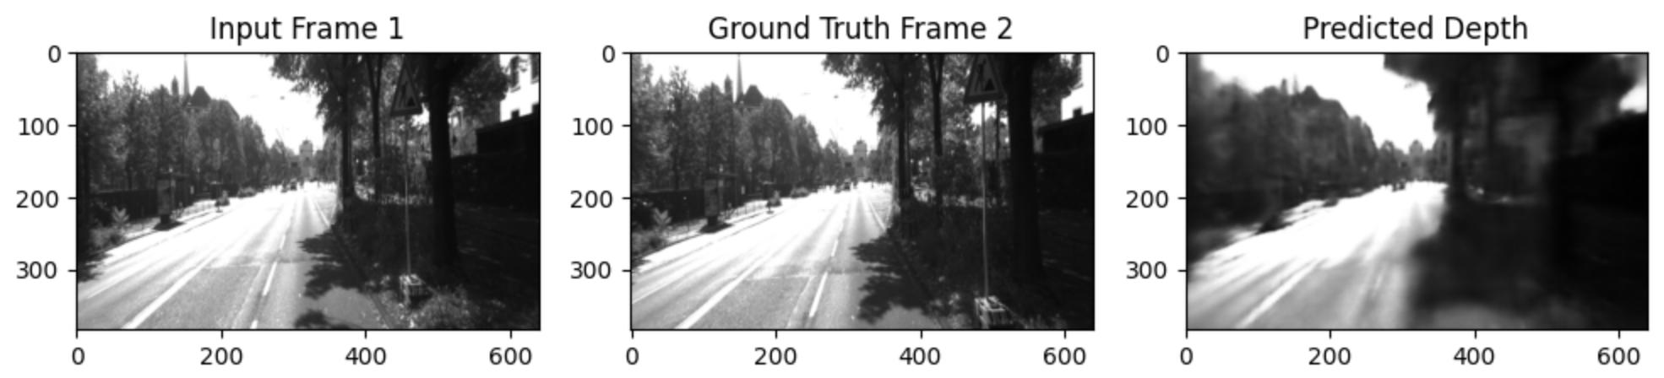
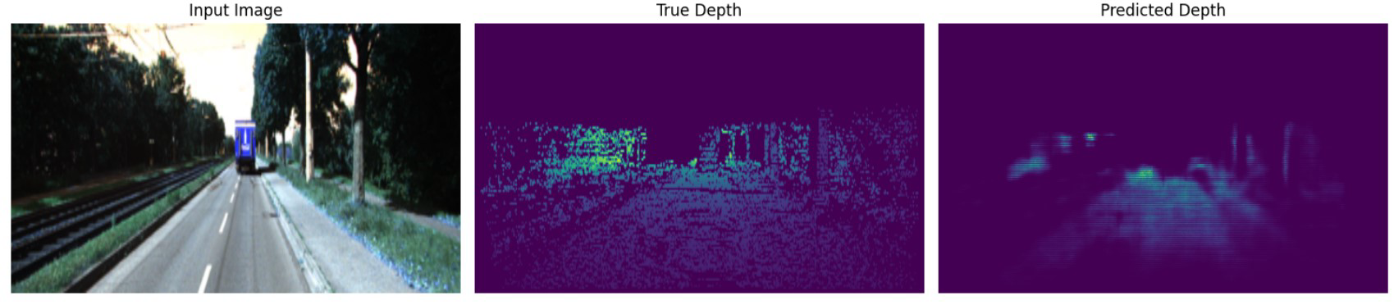
Seeing Is Believing!
Results

Slide 10
Seeing Is Believing!
Results

Slide 11
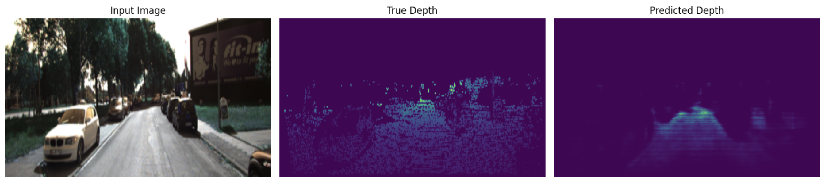
Seeing Is Believing!
Results

Slide 12
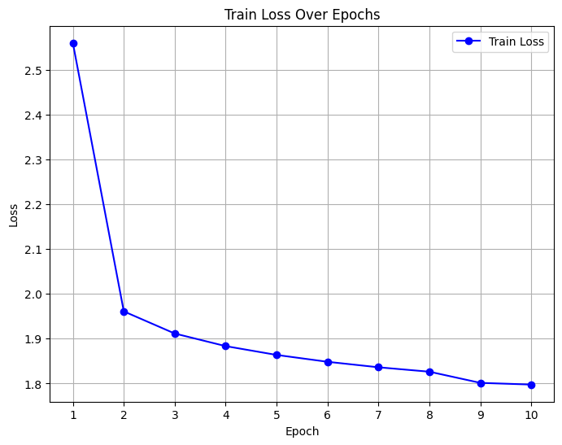
Loss Graphs

Slide 13
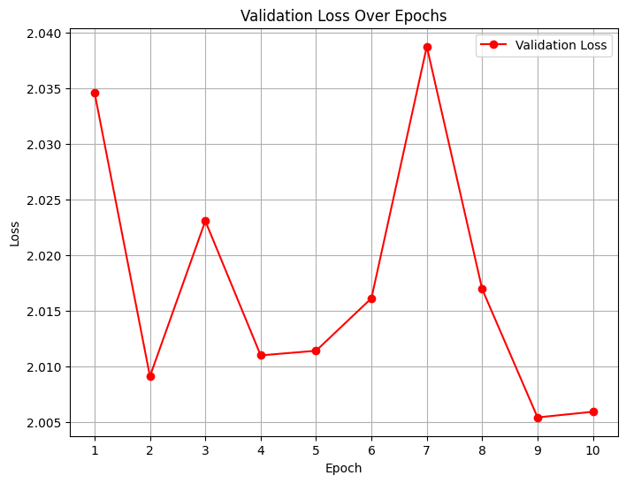
Loss Graphs

Slide 14
Conclusion
Developed a Robust Depth Estimation Model: Utilized self-supervised learning to overcome limitations of diverse datasets.
Enhanced Efficiency: Achieved reliable performance with minimal reliance on labeled data.
Real-World Applicability: Delivered a framework optimized for real-time use in dynamic environments.

Slide 15

When Depth Gets Messy
Occlusions: Objects in consecutive frames may obscure parts of the scene, disrupting temporal coherence.
Dynamic Objects: Moving objects (e.g., cars, pedestrians) may introduce inconsistencies between frames.
Lighting Variations: Sudden changes in illumination between frames can affect photometric loss.

Slide 16

Where Depth Finds Purpose
Real-Time Applications:
Self-driving cars.
Robotics navigation.
Augmented Reality.

Slide 17
Next Steps: Depth Dive!
Enhance temporal modeling.
Explore diverse datasets for generalization.
Apply advanced augmentations like random lighting changes, Gaussian noise, and affine transformations to simulate real-world scenarios.

Slide 18

Thanks for Diving Deep with Us!

Slide 19


